Slide 1
Inventor iLogic Step by Step Debugging
Markus Koechl
Solutions Engineer PDM|PLM – Autodesk Central Europe

Slide 2
Remarks
Inventor iLogic Step by Step Debugging is part of a series of iLogic – Vault rule samples, snippet collections and an application extension integrating Vault commands with rules.
The Visual Studio project is available for public download
Download Development Project and Sources – GitHub
Notes:
1) „Snippets“ are pre-defined pieces of code for fast and convenient re-use. Double-click to insert into code editor window.

Slide 3
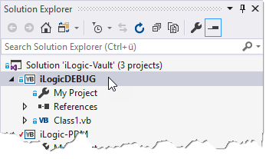
iLogic | Visual Studio Debugging
Connect Visual Studio to Inventor iLogic for step by step debugging
The iLogic-Vault Solution shares a debugging project ready to go
Empty VB Class
Notes:
1) „Snippets“ are pre-defined pieces of code for fast and convenient re-use. Double-click to insert into code editor window.

Slide 4
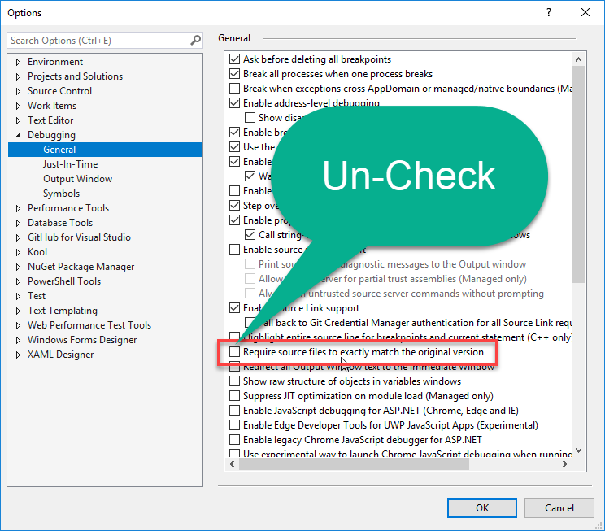
iLogic | Visual Studio Debugging
Required Setting to allow Visual Studio ignore the code differences of iLogic Syntax to VB.NET syntax

Slide 5
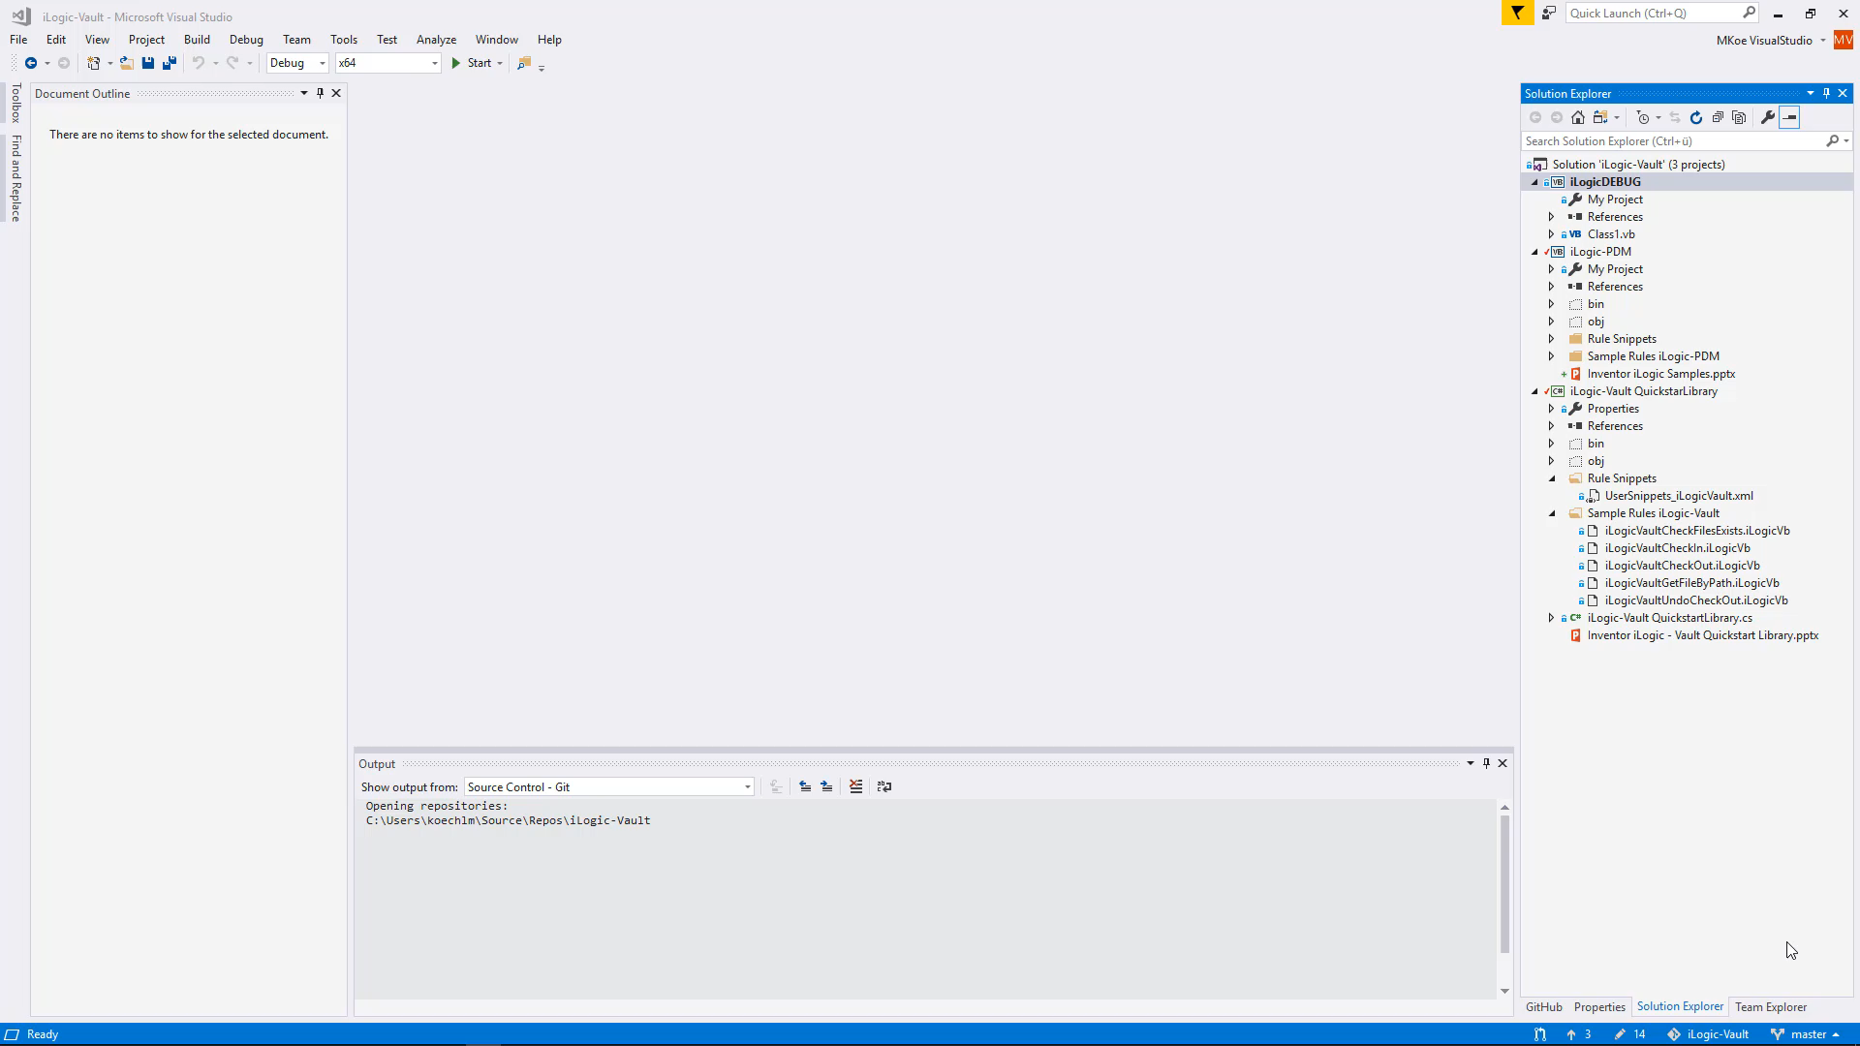
iLogic | Visual Studio Debugging

Slide 6
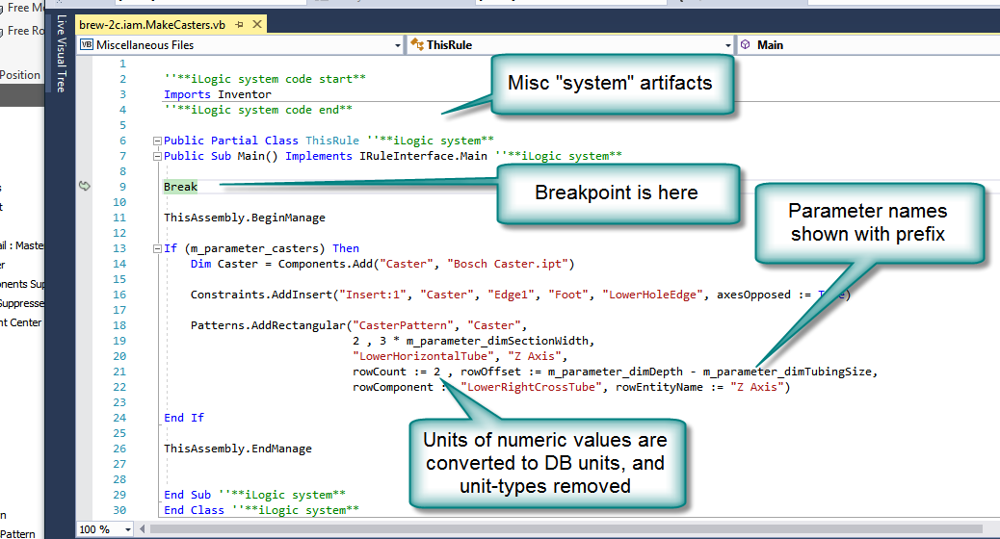
iLogic | Visual Studio Debugging
Additional Information & Tips

Slide 7
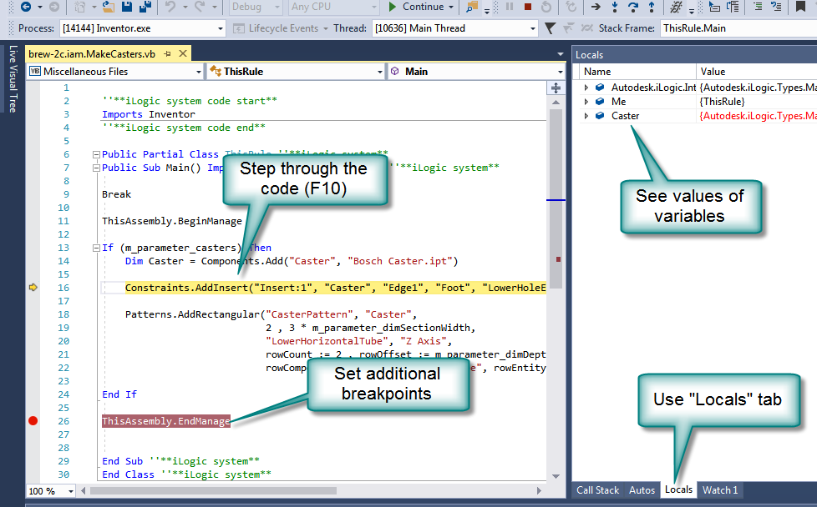
iLogic | Visual Studio Debugging
Additional Information & Tips

